Slide 1

MACHINE
INTELLIGENCE
Hidden Markov Model
K.S.Srinivas
Department of Computer Science and Engineering

Slide 2

MACHINE INTELLIGENCE
Hidden Markov Model - Estimation
K.S.Srinivas
Department of Computer Science and Engineering

Slide 3
MACHINE INTELLIGENCE
Hidden Markov Model
Until now we assumed that the instances that constitute a sample are IID
Likelihood(sample)=Π Likelihood(instance)
But consider the following samples
Dependence of letter in a word
Dependence of base pairs in DNA sequence
Dependence of successive phonemes in a speech
With HMM, we determine the internal state by making observations

Slide 4

MACHINE INTELLIGENCE
Hidden Markov Model
HMM models a process with a First Order Markov process.
It includes the initial state distribution π (the probability distribution of the initial state)
The transition probabilities A from one state (xt) to another.
HMM also contains the likelihood B of the observation (yt) given a hidden state. Matrix B is called the emission probabilities. It demonstrates the probability of our observation given a specific internal state.
Hidden states – Markov chain:
–Dependent only on the previous state
–“The past is independent of the future given the present.”

Slide 5
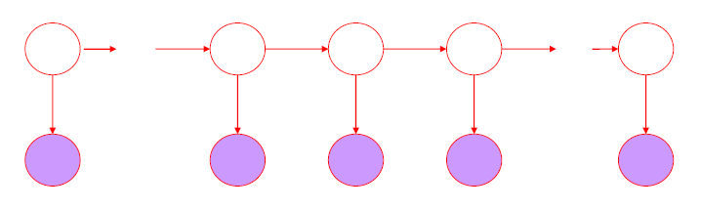
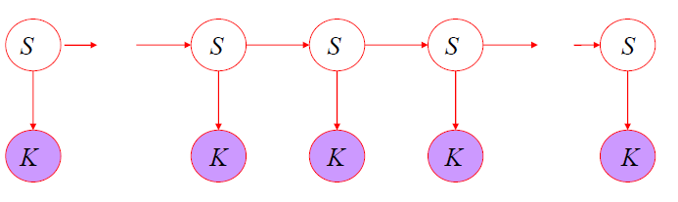
MACHINE INTELLIGENCE
Hidden Markov Model - Formalism
Hidden states – Markov chain:
–Dependent only on the previous state
–“The past is independent of the future given the present.”
•Shaded nodes are observed variables
•Dependent only on their corresponding hidden state
N and M are defined implicitly
•S : {s1…sN } are the values for the hidden states
•K : {k1…kM } are the values for the observations

Slide 6
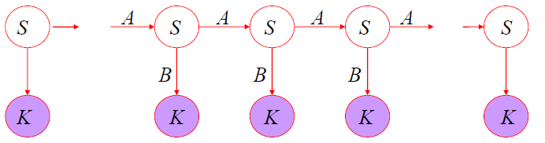
MACHINE INTELLIGENCE
Hidden Markov Model - Formalism
Hidden states – Markov chain:
–Dependent only on the previous state
–“The past is independent of the future given the present.”
• Parameters: {S, K, P, A, B}
• Initial hidden state probabilities: P = {pi}
• Transition probabilities. A = {aij} are the state transition probabilities.
• Emission probabilities. B = {bik} are the observation state probabilities (HMM can also work with continues emission probabilities).
N and M are defined implicitly

Slide 7
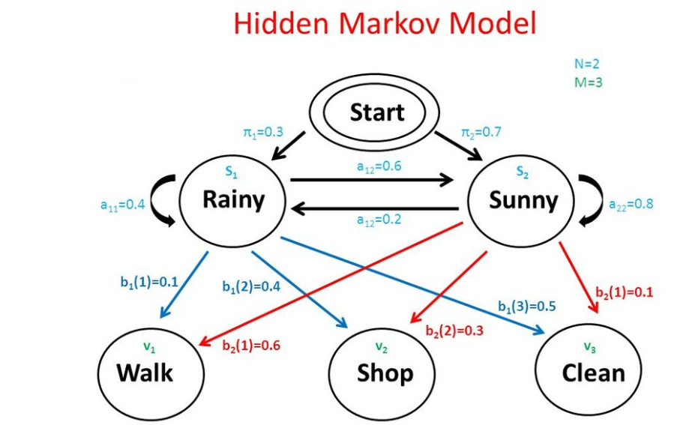
MACHINE INTELLIGENCE
Hidden Markov Model - Formalism
Parameters: {S, K, P, A, B}
• Initial hidden state probabilities: P = {πι}
• Transition probabilities. A = {aij} are the state transition probabilities.
• Emission probabilities. B = {bik} are the observation state probabilities

Slide 8
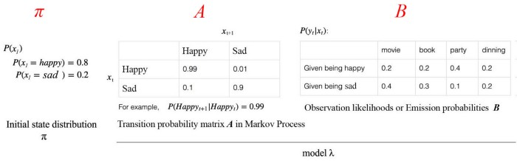
MACHINE INTELLIGENCE
HMM
The complexity of the problem is that the same observations may be originated from different states (happy or not).

Slide 9

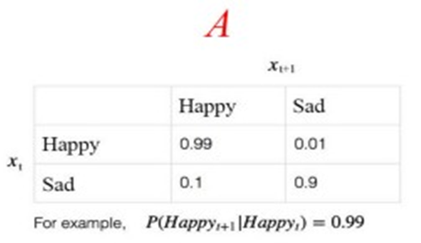
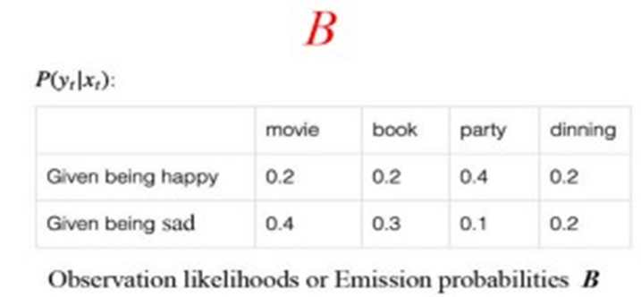
MACHINE INTELLIGENCE
HMM
Two major assumptions are made in HMM. The next state and the current observation solely depend on the current state only.

Slide 10
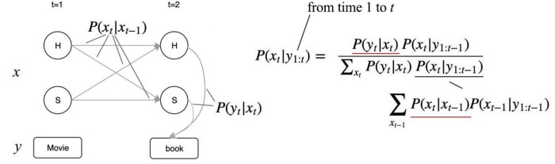
MACHINE INTELLIGENCE
HMM
Given all the observable and the initial state distribution, we can compute a pretty complex equation for the probability for the internal state x_{t} P(x_{t}| y₁, y₂, y₃, … , y_{t}) at time t.
For simplicity here, we will not include π in our equation. All equations assume π is a given condition, like P(y) → P(y|π).
The equation uses the transition probability and the emission probability to compute the probability of the internal state based on all observations.

Slide 11
MACHINE INTELLIGENCE
HMM
Depending on the situation, we usually ask three different types of questions regarding an HMM problem.
Likelihood: How likely are the observations based on the current model or the probability of being at a state at a specific time step.
Decoding: Find the internal state sequence based on the current model and observations.
Learning. Learn the HMM model.

Slide 12
MACHINE INTELLIGENCE
HMM
1. Probability of an Observation Sequence:
Given a model μ = (A,B,) over S,K, how do we (efficiently)
compute the likelihood of a particular sequence,
P(O|μ)?
2. Finding the “Best” State Sequence:
Given an observation sequence and a model, how do we
choose a state sequence (X1, . . . ,XT+1) to best explain the
observation sequence?
3. HMM Parameter Estimation:
Given an observation sequence (or corpus thereof), how
do we acquire a model μ = (A,B,) that best explains the
data?

Slide 13
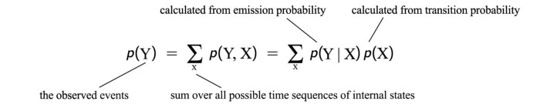
MACHINE INTELLIGENCE
Likelihood (likelihood of the observation)
Likelihood is to find the likelihood of observation Y.
This is computationally intense.

Slide 14
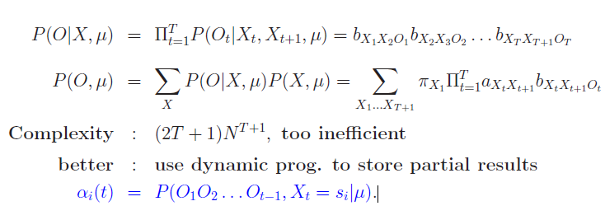
MACHINE INTELLIGENCE
Probability of an Observation Sequence

Slide 15
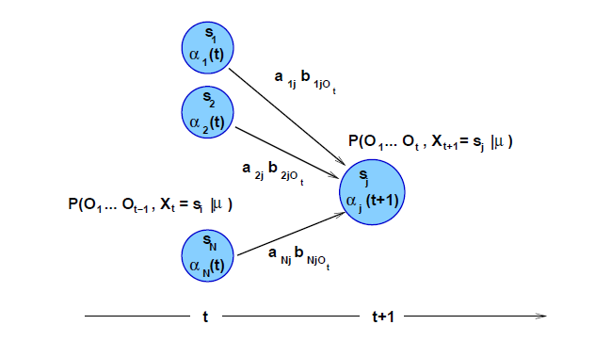
MACHINE INTELLIGENCE
Probability of an Observation Sequence
αi(t) = P(O1O2 . . .Ot,Xt = si|μ).
The probability of moving from state S_{i} to state S_{j} is given by the probability in the transition matrix A more formally as a_{ij}
Having moved to S_{j} the probability of emitting O_{t+1} is given by b_{j}(O_{t+1})
αi(t) is the probability of a machine being in state i at time t and producing observation o1,o2,03…. 0t-1

Slide 16
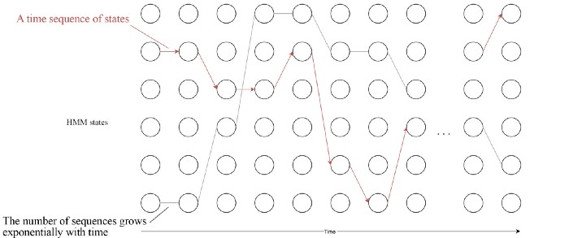
MACHINE INTELLIGENCE
Likelihood (likelihood of the observation)
In HMM, we solve the problem at time t by using the result from time t-1
A circle below represents an HMM hidden state j at time t. So even the number of state sequence increases exponentially with time, we can solve it linear if we can express the calculation recursively with time.
This is the idea of dynamic programming that breaks the exponential curse

Slide 17
MACHINE INTELLIGENCE
Probability of an Observation Sequence
αi(t) = P(O1O2 . . .Ot,Xt = si|μ).
As we can see from the diagram on the right as we explained earlier we can express this recursively int terms of the earlier α s
We Will prove this in our next slide and explain this with an examples

Slide 18
MACHINE INTELLIGENCE
Probability of an Observation Sequence
αi(t) = P(O1O2 . . .Ot,Xt = si|μ).
As we can see from the diagram on the right as we explained earlier we can express this recursively int terms of the earlier α s
We Will prove this in our next slides, explain the forward algorithm and explain this with an examples

Slide 19

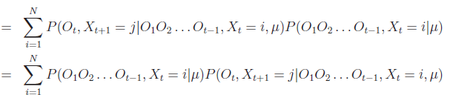
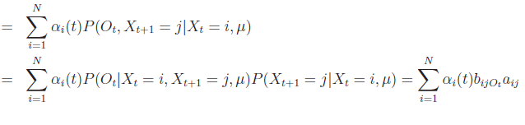
MACHINE INTELLIGENCE
Proof of the alpha probability
αi(t) = P(O1O2 . . .Ot,Xt = si|μ).

Slide 20
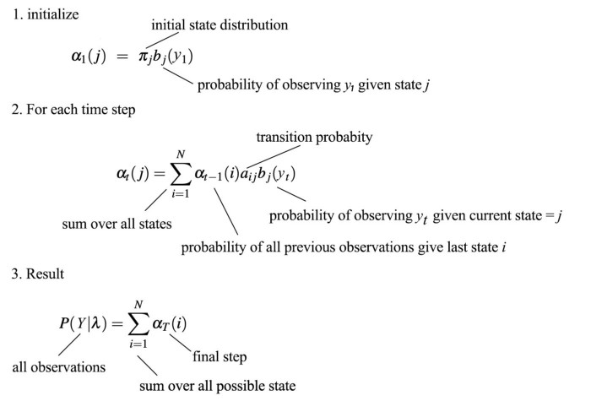
MACHINE INTELLIGENCE
The forward algorithm
Thus the likelihood of the observations can be calculated recursively for each time step below.:

Slide 21
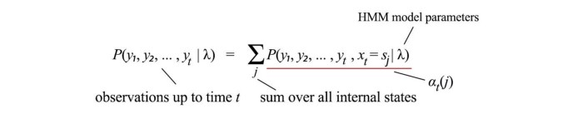
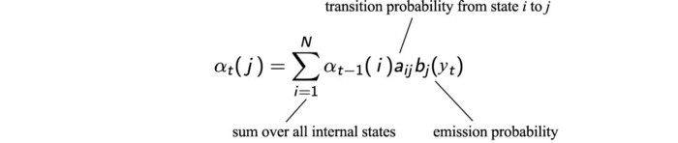
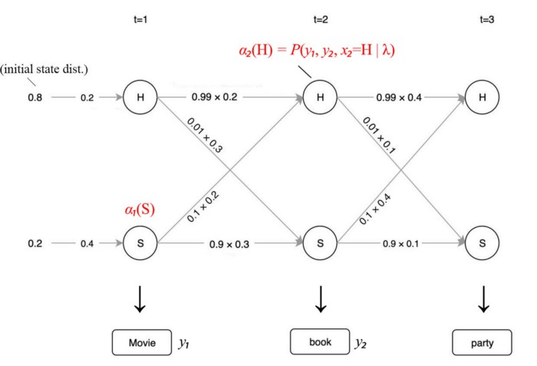
MACHINE INTELLIGENCE
Toy Example of Forward Algorithm
At time t, the probability of our observations up to time t is:
Let’s rename the term underlined in red above as α_{t}(j) (forward probability) and we can express it recursively.

Slide 22
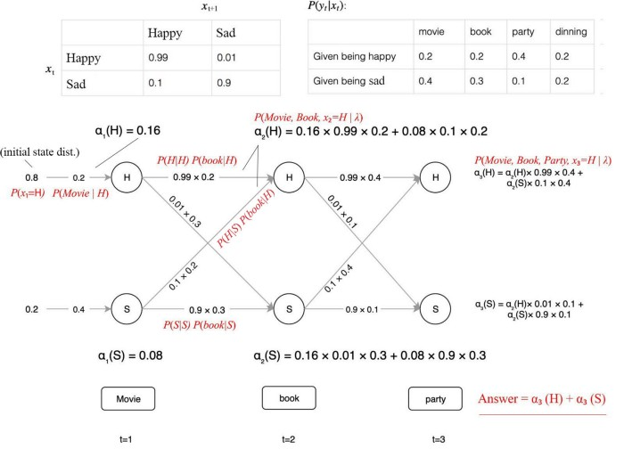
MACHINE INTELLIGENCE
HMM
Consider this example in which we start with the initial state distribution on the left.
Then we propagate the value of α to the right for each timestep.
Therefore, we break the curse of exponential complexity.

Slide 23
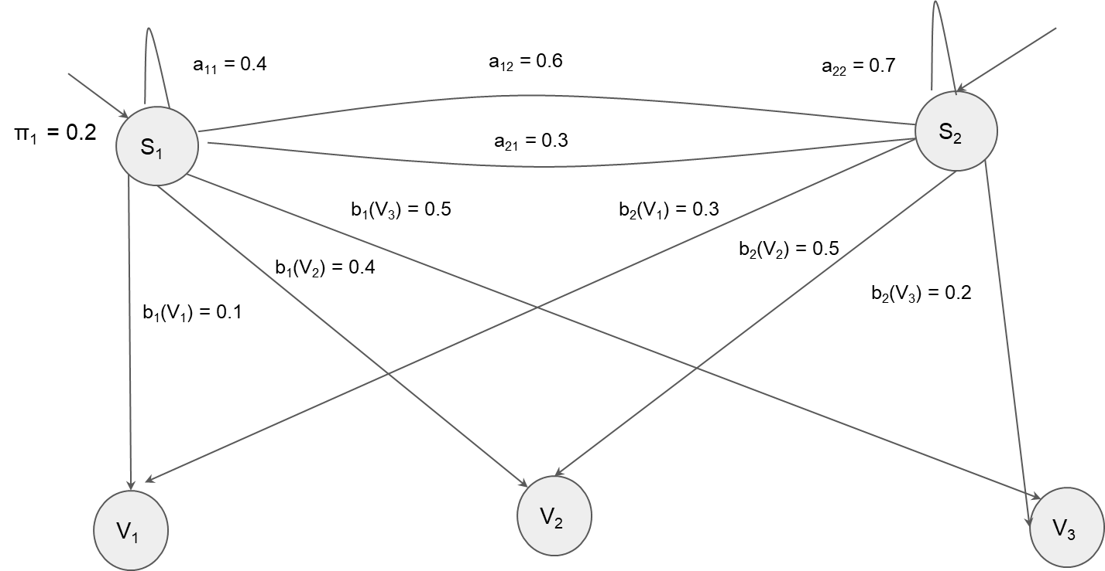
MACHINE INTELLIGENCE
HMM – Canonical Example Problem
π₂ = 0.8

Slide 24
MACHINE INTELLIGENCE
HMM
Alpha rule method to find Probability of an Observation Sequence
To Find P(O = {V₁,V₃,V₂} | λ), make alpha table, sum up last column
 | t =1 (V₁ is observed) | t =2 (V₃ is observed) | t =3(V₂ is observed)
S₁
S₂
To calculate some cell, take previous time step alpha values and multiply each with transition probability of corresponding cells and add them up. (Σα_{t}(i)*a_{ij}). Multiply this sum with observation probability b_{i}(O_{t+1}) to get
(Σα_{t}(i)*a_{ij})*b_{i}(O_{t+1}) = α_{t+1} at this cell.

Slide 25
Alpha rule method to find Probability of an Observation Sequence
MACHINE INTELLIGENCE
HMM
To Find P(O = {V₁,V₃,V₂} | λ), make alpha table, sum up last column
 | t =1 (V₁ is observed) | t =2 (V₃ is observed) | t =3(V₂ is observed)
S₁
S₂
To calculate this cell, take previous time step alpha values and multiply each with transition probability of corresponding cells and add them up. But, This is first column. α1(i) = πi*bi(O1)

Slide 26
Alpha rule method to find Probability of an Observation Sequence
MACHINE INTELLIGENCE
HMM
To Find P(O = {V₁,V₃,V₂} | λ), make alpha table, sum up last column
 | t =1 (V₁ is observed) | t =2 (V₃ is observed) | t =3(V₂ is observed)
S₁
S₂
π_{i} = π₁ = 0.2
b_{i} (O₁) = b₁(V₁) = 0.1
α₁(i) = π_{i}*b_{i}(O₁) = 0.02

Slide 27
Alpha rule method to find Probability of an Observation Sequence
MACHINE INTELLIGENCE
HMM
To Find P(O = {V₁,V₃,V₂} | λ), make alpha table, sum up last column
 | t =1 (V₁ is observed) | t =2 (V₃ is observed) | t =3(V₂ is observed)
S₁ | 0.02
S₂
π_{i} = π₂ = 0.8
b_{i} (O₁) = b₂(V₁) = 0.3
α₁(i) = π_{i}*b_{i}(O₁) = 0.24

Slide 28
Alpha rule method to find Probability of an Observation Sequence
MACHINE INTELLIGENCE
HMM
To Find P(O = {V₁,V₃,V₂} | λ), make alpha table, sum up last column
 | t =1 (V₁ is observed) | t =2 (V₃ is observed) | t =3(V₂ is observed)
S₁ | 0.02
S₂ | 0.24
To calculate this cell, take previous time step alpha values and multiply each with transition probability of corresponding cells and add them up. (Σα_{t}(i)*a_{ij}). Multiply this sum with observation probability b_{i}(O_{t+1}) to get (Σα_{t}(i)*a_{ij})*b_{i}(O_{t+1}) = α_{t+1} at this cell.

Slide 29
Alpha rule method to find Probability of an Observation Sequence
MACHINE INTELLIGENCE
HMM
To Find P(O = {V₁,V₃,V₂} | λ), make alpha table, sum up last column
 | t =1 (V₁ is observed) | t =2 (V₃ is observed) | t =3(V₂ is observed)
S₁ | 0.02
S₂ | 0.24
a₁₁ = 0.4
a₂₁ = 0.3
(Σα_{t}(i)*a_{ij}) = (0.02 * 0.4 + 0.24 *0.3)=0.08
b_{t}(O_{t+1}) = b₁(V₃) = 0.5
α_{t+1} at this cell = (Σα_{t}(i)*a_{ij})*b_{i}(O_{t+1}) = 0.04

Slide 30
Alpha rule method to find Probability of an Observation Sequence
MACHINE INTELLIGENCE
HMM
To Find P(O = {V₁,V₃,V₂} | λ), make alpha table, sum up last column
 | t =1 (V₁ is observed) | t =2 (V₃ is observed) | t =3(V₂ is observed)
S₁ | 0.02
S₂ | 0.24
a₁₁ = 0.4
a₂₁ = 0.3
(Σα_{t}(i)*a_{ij}) = (0.02 * 0.4 + 0.24 *0.3)=0.08
b_{t}(O_{t+1}) = b₁(V₃) = 0.5
α_{t+1} at this cell = (Σα_{t}(i)*a_{ij})*b_{i}(O_{t+1}) = 0.04

Slide 31
Alpha rule method to find Probability of an Observation Sequence
MACHINE INTELLIGENCE
HMM
To Find P(O = {V₁,V₃,V₂} | λ), make alpha table, sum up last column
 | t =1 (V₁ is observed) | t =2 (V₃ is observed) | t =3(V₂ is observed)
S₁ | 0.02
S₂ | 0.24
a₁₁ = 0.4
a₂₁ = 0.3
(Σα_{t}(i)*a_{ij}) = (0.02 * 0.4 + 0.24 *0.3)=0.08
b_{t}(O_{t+1}) = b₁(V₃) = 0.5
α_{t+1} at this cell = (Σα_{t}(i)*a_{ij})*b_{i}(O_{t+1}) = 0.04

Slide 32
Alpha rule method to find Probability of an Observation Sequence
MACHINE INTELLIGENCE
HMM
To Find P(O = {V₁,V₃,V₂} | λ), make alpha table, sum up last column
 | t =1 (V₁ is observed) | t =2 (V₃ is observed) | t =3(V₂ is observed)
S₁ | 0.02 | 0.04
S₂ | 0.24 | 0.036
a₁₁ = 0.4
a₂₁ = 0.3
(Σα_{t}(i)*a_{ij}) = (0.04 * 0.4 + 0.036 *0.3) = 0.0268
b_{t}(O_{t+1}) = b₁(V₂) = 0.4
α_{t+1} at this cell = (Σα_{t}(i)*a_{ij})*b_{i}(O_{t+1}) = 0.01072

Slide 33
Alpha rule method to find Probability of an Observation Sequence
MACHINE INTELLIGENCE
HMM
To Find P(O = {V₁,V₃,V₂} | λ), make alpha table, sum up last column
 | t =1 (V₁ is observed) | t =2 (V₃ is observed) | t =3(V₂ is observed)
S₁ | 0.02 | 0.04 | 0.01072
S₂ | 0.24 | 0.036
a₁₂ = 0.6
a₂₂ = 0.7
(Σα_{t}(i)*a_{ij}) = (0.04 * 0.6 + 0.036 *0.7) = 0.0492
b_{t}(O_{t+1}) = b₂(V₂) = 0.5
α_{t+1} at this cell = (Σα_{t}(i)*a_{ij})*b_{i}(O_{t+1}) = 0.0246

Slide 34
MACHINE
INTELLIGENCE
Hidden Markov Model
K.S.Srinivas
Department of Computer Science and Engineering

Slide 35
MACHINE INTELLIGENCE
Decoding – Hidden Markov Model
K.S.Srinivas
Department of Computer Science and Engineering

Slide 36
MACHINE INTELLIGENCE
Proof of the alpha probability
αi(t) = P(O1O2 . . .Ot,Xt = si|μ).

Slide 37
MACHINE INTELLIGENCE
The forward algorithm
Thus the likelihood of the observations can be calculated recursively for each time step below.:

Slide 38
MACHINE INTELLIGENCE
HMM
Consider this example in which we start with the initial state distribution on the left.
Then we propagate the value of α to the right for each timestep.
Therefore, we break the curse of exponential complexity.

Slide 39
MACHINE INTELLIGENCE
Backward Probability
The backward probability β is the probability of seeing the observations from time t +1 to the end, given that we are in state i at time t (and given the automaton l):

Slide 40
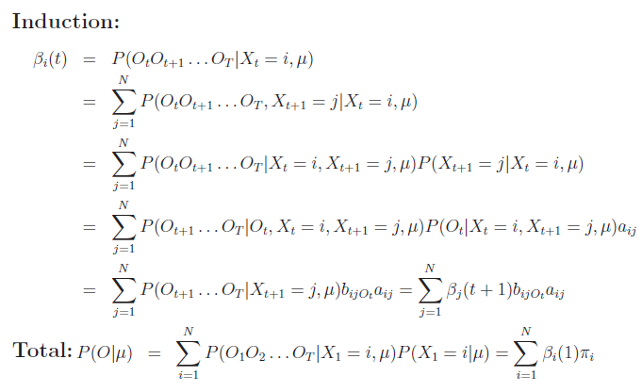
MACHINE INTELLIGENCE
Backward Probability Proof

Slide 41
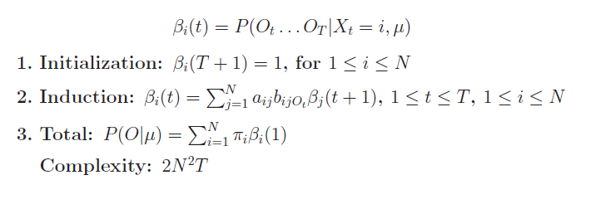
MACHINE INTELLIGENCE
Backward Probability Algorithm

Slide 42
MACHINE INTELLIGENCE
HMM – Canonical Example Problem with backward probability
π₂ = 0.8

Slide 43
Beta Table
Observation sequence = O = {V₁,V₃,V₂}
 | t =1 (V₁ is observed) | t =2 (V₃ is observed) | t =3(V₂ is observed)
S₁
S₂
To fill up beta table, initialize last column as 1’s

Slide 44
Beta Table
Observation sequence = O = {V₁,V₃,V₂}
 | t =1 (V₁ is observed) | t =2 (V₃ is observed) | t =3(V₂ is observed)
S₁ |  |  | 1
S₂ |  |  | 1
To calculate Beta value at some cell, take beta values at next column, multiply each with corresponding transition probabilities to get a_{ij} * β_{t+1}(j). Multiply each of these values with corresponding b_{j}(O_{t+1}) to get a_{ij} * β_{t+1}(j) * b_{j}(O_{t+1}). Finally add them up to get Σa_{ij} * β_{t+1}(j) * b_{j}(O_{t+1}) = Beta value at this cell.

Slide 45
Beta Table
Observation sequence = O = {V₁,V₃,V₂}
 | t =1 (V₁ is observed) | t =2 (V₃ is observed) | t =3(V₂ is observed)
S₁ |  |  | 1
S₂ |  |  | 1
a₁₁ = 0.4
b₁(V₂) = 0.4
a₁₂ = 0.6
b₂(V₂) = 0.5
b₁(V₂) = 0.4, b₂(V₂) = 0.5
corresponding beta at next cell *a₁₁* b₁(V₂) = 1*0.4*0.4 = 0.16
corresponding beta at next cell *a₁₂* b₂(V₂) = 1*0.6*0.5 = 0.30
Beta value at this cell = 0.16+0.30 = 0.46

Slide 46
Beta Table
Observation sequence = O = {V₁,V₃,V₂}
 | t =1 (V₁ is observed) | t =2 (V₃ is observed) | t =3(V₂ is observed)
S₁ |  | 0.46 | 1
S₂ |  |  | 1
a₂₁ = 0.3
b₁(V₂) = 0.4
a₂₂ = 0.7
b₂(V₂) = 0.5
b₁(V₂) = 0.4, b₂(V₂) = 0.5
corresponding beta at next cell *a₂₁* b₁(V₂) = 1*0.3*0.4 = 0.12
corresponding beta at next cell *a₂₂* b₂(V₂) = 1*0.7*0.5 = 0.35
Beta value at this cell = 0.12+0.35 = 0.47

Slide 47
Beta Table
Observation sequence = O = {V₁,V₃,V₂}
b₁(V₃) = 0.5
 | t =1 (V₁ is observed) | t =2 (V₃ is observed) | t =3(V₂ is observed)
S₁ |  | 0.46 | 1
S₂ |  | 0.47 | 1
a₁₁ = 0.4
a₁₂ = 0.6
b₂(V₃) = 0.2
b₁(V₃) = 0.5, b₂(V₃) = 0.2
corresponding beta at next cell *a₁₁* b₁(V₂) = 0.46*0.4*0.5 = 0.0920
corresponding beta at next cell *a₁₂* b₂(V₂) = 0.47*0.6*0.2 = 0.0564
Beta value at this cell = 0.0920+0.0564 = 0.1484

Slide 48
Beta Table
Observation sequence = O = {V₁,V₃,V₂}
b₁(V₃) = 0.5
 | t =1 (V₁ is observed) | t =2 (V₃ is observed) | t =3(V₂ is observed)
S₁ | 0.1484 | 0.46 | 1
S₂ |  | 0.47 | 1
a₂₁ = 0.3
a₂₂ = 0.7
b₂(V₃) = 0.2
b₁(V₃) = 0.5, b₂(V₃) = 0.2
corresponding beta at next cell *a₂₁* b₁(V₂) = 0.46*0.3*0.5 = 0.0690
corresponding beta at next cell *a₂₂* b₂(V₂) = 0.47*0.7*0.2 = 0.0658
Beta value at this cell = 0.0690+0.0658 = 0.1348

Slide 49
Beta Table
Observation sequence = O = {V₁,V₃,V₂}
 | t =1 (V₁ is observed) | t =2 (V₃ is observed) | t =3(V₂ is observed)
S₁ | 0.1484 | 0.46 | 1
S₂ | 0.1348 | 0.47 | 1

Slide 50
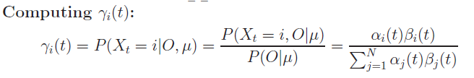
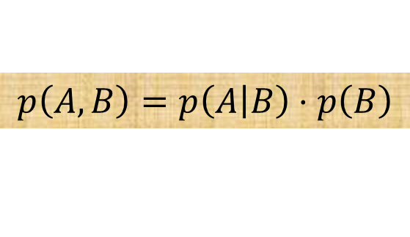
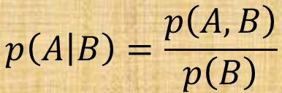

MACHINE INTELLIGENCE
Forward and Backward Procedure
To learn the HMM model, we need to know what states we are to explain the observations the best.
That will be the occupation probability γ — the probability of state i at time t given all the observations.
Given the HMM model parameters fixed, we can apply the forward and backward algorithm to calculate α and β from the observations. γ can be calculated by simply multiplying α with β, and then renormalize it.
.
$$p\left(A,B\right)=p\left(\left.A\right|B\right)⋅p\left(B\right)$$
$$p\left(\left.A\right|B\right)=\frac{p\left(A,B\right)}{p\left(B\right)}$$

Slide 51


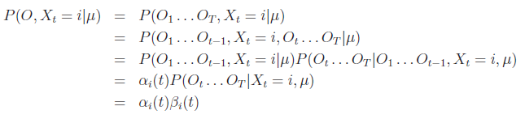

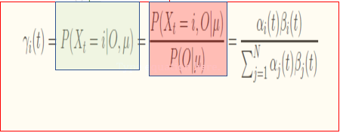
MACHINE INTELLIGENCE
Decoding- 2 methods -1st Method

Slide 52
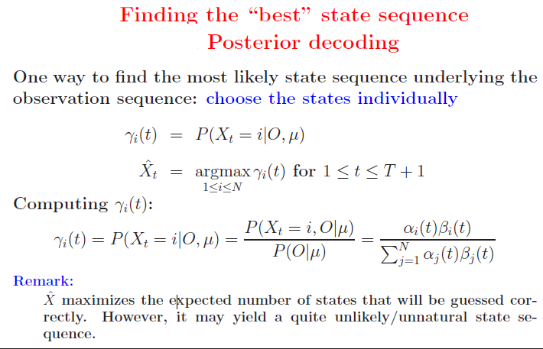
MACHINE INTELLIGENCE
Posterior Decoding

Slide 53
To Find Probability of an Observation Sequence using both Alpha and Beta Tables
Observation sequence = O = {V₁,V₃,V₂}
Alpha table:
 | t =1 (V₁ is observed) | t =2 (V₃ is observed) | t =3(V₂ is observed)
S₁ | 0.02 | 0.04 | 0.01072
S₂ | 0.24 | 0.036 | 0.0246
Beta table
 | t =1 (V₁ is observed) | t =2 (V₃ is observed) | t =3(V₂ is observed)
S₁ | 0.1484 | 0.46 | 1
S₂ | 0.1348 | 0.47 | 1

Slide 54
To Find Probability of an Observation Sequence using both Alpha and Beta Tables
Observation sequence = O = {V₁,V₃,V₂}
Take any column of alpha table and then take corresponding column of beta table and do dot product.
If we consider first column, to find P(O = {V₁,V₃,V₂} | λ):
First column values of Alpha table = {0.02, 0.24}
First column values of Beta table = {0.1484,0.1348}
P(O = {V₁,V₃,V₂} | λ) = 0.02*0.1484+0.24*0.1348 =0.03532

Slide 55
To Find Probability of an Observation Sequence using both Alpha and Beta Tables
Observation sequence = O = {V₁,V₃,V₂}
Take any column of alpha table and then take corresponding column of beta table and do dot product.
If we consider second column, to find P(O = {V₁,V₃,V₂} | λ):
Second column values of Alpha table = {0.04, 0.036}
Second column values of Beta table = {0.46,0.47}
P(O = {V₁,V₃,V₂} | λ) = 0.04*0.46+0.036*0.47 =0.03532

Slide 56
To Find Probability of an Observation Sequence using both Alpha and Beta Tables
Observation sequence = O = {V₁,V₃,V₂}
Take any column of alpha table and then take corresponding column of beta table and do dot product.
If we consider last column, to find P(O = {V₁,V₃,V₂} | λ):
Last column values of Alpha table = {0.01072, 0.0246}
Last column values of Beta table = {1,1}
P(O = {V₁,V₃,V₂} | λ) = 0.01072*1+0.0246*1 =0.03532

Slide 57
Gamma Table
 | t =1 (V₁ is observed) | t =2 (V₃ is observed) | t =3(V₂ is observed)
S₁ | 0.02 | 0.04 | 0.01072
S₂ | 0.24 | 0.036 | 0.0246
Alpha table
To Find Gamma value at some cell multiply corresponding alpha and beta values at that cell position and divide by probability of observation sequence
 | t =1 (V₁ is observed) | t =2 (V₃ is observed) | t =3(V₂ is observed)
S₁ | 0.1484 | 0.46 | 1
S₂ | 0.1348 | 0.47 | 1
Beta Table
 | t =1 (V₁ is observed) | t =2 (V₃ is observed) | t =3(V₂ is observed)
S₁
S₂

Slide 58
Gamma Table
 | t =1 (V₁ is observed) | t =2 (V₃ is observed) | t =3(V₂ is observed)
S₁ | 0.02 | 0.04 | 0.01072
S₂ | 0.24 | 0.036 | 0.0246
gamma at this cell =
0.01072 *1/0.03532 = 0.30351
Alpha table
 | t =1 (V₁ is observed) | t =2 (V₃ is observed) | t =3(V₂ is observed)
S₁ | 0.1484 | 0.46 | 1
S₂ | 0.1348 | 0.47 | 1
Beta Table
 | t =1 (V₁ is observed) | t =2 (V₃ is observed) | t =3(V₂ is observed)
S₁
S₂

Slide 59
Gamma Table
 | t =1 (V₁ is observed) | t =2 (V₃ is observed) | t =3(V₂ is observed)
S₁ | 0.02 | 0.04 | 0.01072
S₂ | 0.24 | 0.036 | 0.0246
gamma at this cell =
0.0246 *1/0.03532 =
0.69648
Alpha table
 | t =1 (V₁ is observed) | t =2 (V₃ is observed) | t =3(V₂ is observed)
S₁ | 0.1484 | 0.46 | 1
S₂ | 0.1348 | 0.47 | 1
Beta Table
 | t =1 (V₁ is observed) | t =2 (V₃ is observed) | t =3(V₂ is observed)
S₁ |  |  | 0.30351
S₂

Slide 60
Gamma Table
 | t =1 (V₁ is observed) | t =2 (V₃ is observed) | t =3(V₂ is observed)
S₁ | 0.02 | 0.04 | 0.01072
S₂ | 0.24 | 0.036 | 0.0246
gamma at this cell =
0.04 *0.46/0.03532 =
0.52095
Alpha table
 | t =1 (V₁ is observed) | t =2 (V₃ is observed) | t =3(V₂ is observed)
S₁ | 0.1484 | 0.46 | 1
S₂ | 0.1348 | 0.47 | 1
Beta Table
 | t =1 (V₁ is observed) | t =2 (V₃ is observed) | t =3(V₂ is observed)
S₁ |  |  | 0.30351
S₂ |  |  | 0.69648

Slide 61
Gamma Table
 | t =1 (V₁ is observed) | t =2 (V₃ is observed) | t =3(V₂ is observed)
S₁ | 0.02 | 0.04 | 0.01072
S₂ | 0.24 | 0.036 | 0.0246
gamma at this cell =
0.036 *0.47/0.03532 =
0.47904
Alpha table
 | t =1 (V₁ is observed) | t =2 (V₃ is observed) | t =3(V₂ is observed)
S₁ | 0.1484 | 0.46 | 1
S₂ | 0.1348 | 0.47 | 1
Beta Table
 | t =1 (V₁ is observed) | t =2 (V₃ is observed) | t =3(V₂ is observed)
S₁ |  | 0.52095 | 0.30351
S₂ |  |  | 0.69648

Slide 62
Gamma Table
 | t =1 (V₁ is observed) | t =2 (V₃ is observed) | t =3(V₂ is observed)
S₁ | 0.02 | 0.04 | 0.01072
S₂ | 0.24 | 0.036 | 0.0246
gamma at this cell =
0.02 *0.1484/0.03532 =
0.08403
Alpha table
 | t =1 (V₁ is observed) | t =2 (V₃ is observed) | t =3(V₂ is observed)
S₁ | 0.1484 | 0.46 | 1
S₂ | 0.1348 | 0.47 | 1
Beta Table
 | t =1 (V₁ is observed) | t =2 (V₃ is observed) | t =3(V₂ is observed)
S₁ |  | 0.52095 | 0.30351
S₂ |  | 0.47904 | 0.69648

Slide 63
Gamma Table
 | t =1 (V₁ is observed) | t =2 (V₃ is observed) | t =3(V₂ is observed)
S₁ | 0.02 | 0.04 | 0.01072
S₂ | 0.24 | 0.036 | 0.0246
gamma at this cell =
0.24 *0.1348/0.03532 =
0.91596
Alpha table
 | t =1 (V₁ is observed) | t =2 (V₃ is observed) | t =3(V₂ is observed)
S₁ | 0.1484 | 0.46 | 1
S₂ | 0.1348 | 0.47 | 1
Beta Table
 | t =1 (V₁ is observed) | t =2 (V₃ is observed) | t =3(V₂ is observed)
S₁ | 0.08403 | 0.52095 | 0.30351
S₂ |  | 0.47904 | 0.69648

Slide 64
Gamma Table
 | t =1 (V₁ is observed) | t =2 (V₃ is observed) | t =3(V₂ is observed)
S₁ | 0.02 | 0.04 | 0.01072
S₂ | 0.24 | 0.036 | 0.0246
Sum of gamma values in one column should be 1. (By definition)
Alpha table
 | t =1 (V₁ is observed) | t =2 (V₃ is observed) | t =3(V₂ is observed)
S₁ | 0.1484 | 0.46 | 1
S₂ | 0.1348 | 0.47 | 1
Beta Table
 | t =1 (V₁ is observed) | t =2 (V₃ is observed) | t =3(V₂ is observed)
S₁ | 0.08403 | 0.52095 | 0.30351
S₂ | 0.91596 | 0.47904 | 0.69648

Slide 65

MACHINE INTELLIGENCE
Decoding-Viterbi algorithm
The decoding problem is finding the optimal internal states sequence given a sequence of observations.
Again, we want to express our components recursively.
Given the state is j at time t, v_{t}(j) is the joint probability of the observation sequence with the best state sequence.
If we examine closely, the resulting equation is close to the forward algorithm except the summation is replaced by the max function.

Slide 66
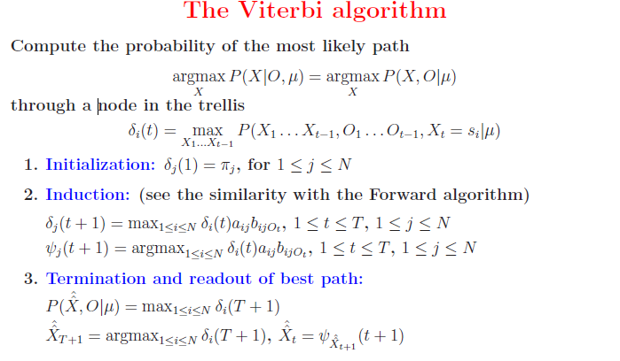
MACHINE INTELLIGENCE
Decoding-Viterbi algorithm

Slide 67
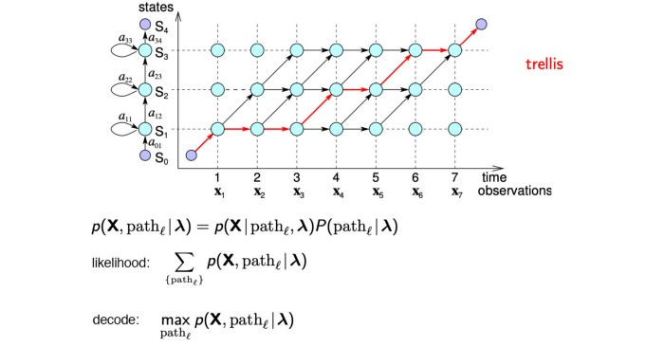
MACHINE INTELLIGENCE
Decoding-Viterbi algorithm
So not only it can be done, the solution is similar to the forward algorithm except the summation is replaced by the maximum function.
Here, instead of summing over all possible state sequences in the forward algorithm, the Viterbi algorithm finds the most likely path.

Slide 68
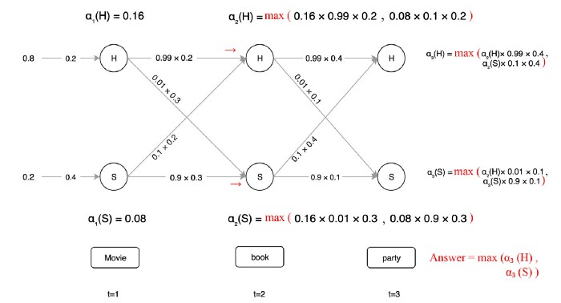
MACHINE INTELLIGENCE
HMM
Finding the internal states that maximize the likelihood of observations is similar to the likelihood method.
We just replace the summation with the maximum function.

Slide 69
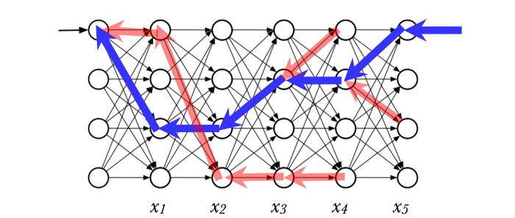
MACHINE INTELLIGENCE
HMM
In this algorithm, we also record the maximum path leading to each node at time t (the red arrow above). e.g. we are transited from a happy state H at t=1 to the happy state H at t=2 above since it is the most optimal (likely) path.

Slide 70
THANK YOU
K.S.Srinivas
srinivasks@pes.edu
+91 80 2672 1983 Extn 701

Slide 71
MACHINE INTELLIGENCE
Casino Time
we will now study famous dishonest casino example.
To cheat, a dealer switches between a fair dice and a biased die. But, to avoid detection, the dealer does it infrequently.
A transition matrix is provided to model the chance of the dealer in switching between the fair dice or biased dice.
We also provide a value distribution (the observed dice value distribution) for each dice. For example, for the fair dice, the dice value will be uniformly distributed — this is the emission probability.
We can use the algorithms described before to make inferences by observing the value of the rolling die even though we don’t know which die is used.

Slide 72
MACHINE
INTELLIGENCE
Hidden Markov Model
K.S.Srinivas
Department of Computer Science and Engineering

Slide 73
MACHINE INTELLIGENCE
Finding the parameters – Hidden Markov Model
K.S.Srinivas
Department of Computer Science and Engineering

Slide 74
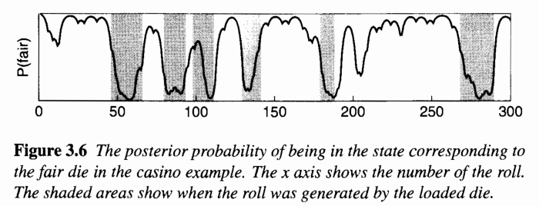
MACHINE INTELLIGENCE
Casino Time
The internal state is which die is used. The line curve above is the likelihood to be at a particular state at time t.
It fluctuates a lot. It gives a narrower view of what may happen at time t.
The shaded area is the likely transition between the fair and the biased dice using the Viterbi algorithm.
It is much smoother and reflects the transition better. It gives a global view on when states on transited.
For the Viterbi algorithm, we find the most likely state sequence that explains the observations. For the likelihood, given different possible sequences, we sum them together accordingly to find the most likely state at time t.

Slide 75
MACHINE INTELLIGENCE
Baum-Welch Algorithm
Besides likelihood and decoding, the last algorithm learns the HMM model parameters λ given the observation.
Here, we will use the Baum–Welch algorithm to learn the transition and the emission probability.
if we know the state occupation probability (the state distribution at time t), we can derive the emission probability and the transition probability.
If we know these two probabilities, we can derive the state distribution at time t

Slide 76
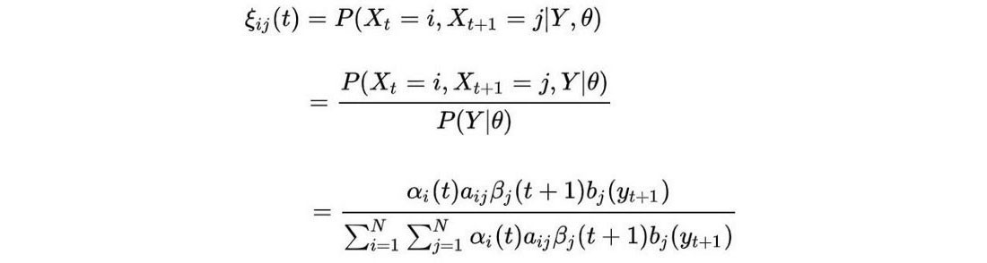
MACHINE INTELLIGENCE
Baum-Welsh Algorithm
ξ is the probability of transiting from state i to j after time t given all the observations. It can be computed by α and β similarly

Slide 77


MACHINE INTELLIGENCE
Baum-Welsh Algorithm
Intuitively, with a fixed HMM model, we refine the state occupation probability (γ) and the transition (ξ) with the given observations.
Here comes the chicken and egg part. Once the distribution of γ and ξ (θ₂) are refined, we can perform a point estimate on what will be the best transition and emission probability (θ₁: a, b).

Slide 78




MACHINE INTELLIGENCE
Baum-Welsh Algorithm
$$Π_{i}=γ_{i}\left(1\right)$$
Probability of the system being in state i at time t

Slide 79
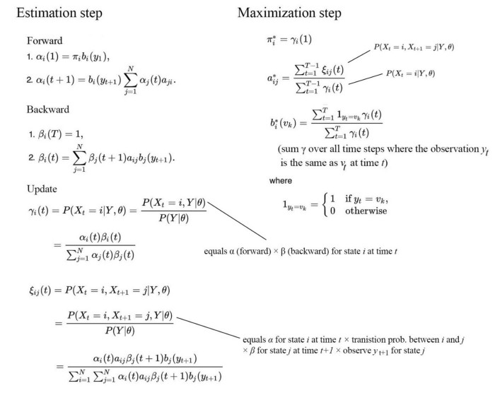
MACHINE INTELLIGENCE
Baum Welsh Algorith,

Slide 80

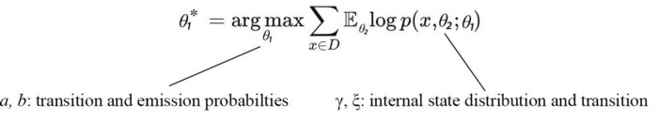
MACHINE INTELLIGENCE
HMM
We fix one set of parameters to improve others and continue the iteration until the solution converges.
The Estimation Maximization algorithm is usually defined as:

Slide 81
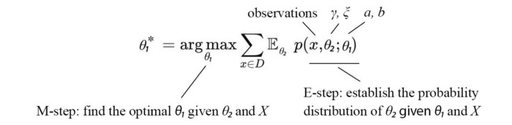
MACHINE INTELLIGENCE
HMM
Here, the E-step establishes p(γ, ξ | x, a, b). Then, the M-step finds a, b that roughly maximizes the objective below.

Slide 82
THANK YOU
K.S.Srinivas
srinivasks@pes.edu
+91 80 2672 1983 Extn 701

